Slide 1
CSE 3217:Mobile Computing
Project Title:CardioNest, A Swift based Mobile Health App Project
Name: Md Rauful Islam Tamim
Roll: 2007009
Name: Md Tashibul Islam
Roll: 2007011
Name: Mezbaur Rahman
Roll: 2007009

Slide 2
CardioNest
Swift Mobile Health App Project

Slide 3
Key Features
Health Information Recording:
- Parameters: Heart rate, systolic & diastolic
pressure, BMI.
Manual entry with date and time picker.
Dynamic BMI calculation based on height and weight.

Slide 4
Application Workflow
1. User signs up or logs in.
2. Health parameters are manually entered and saved.
3. Records displayed in CardView.
4. Details page shows complete data, including BMI.
5. Users can access profile, health tips, or logout via the drawer.

Slide 5
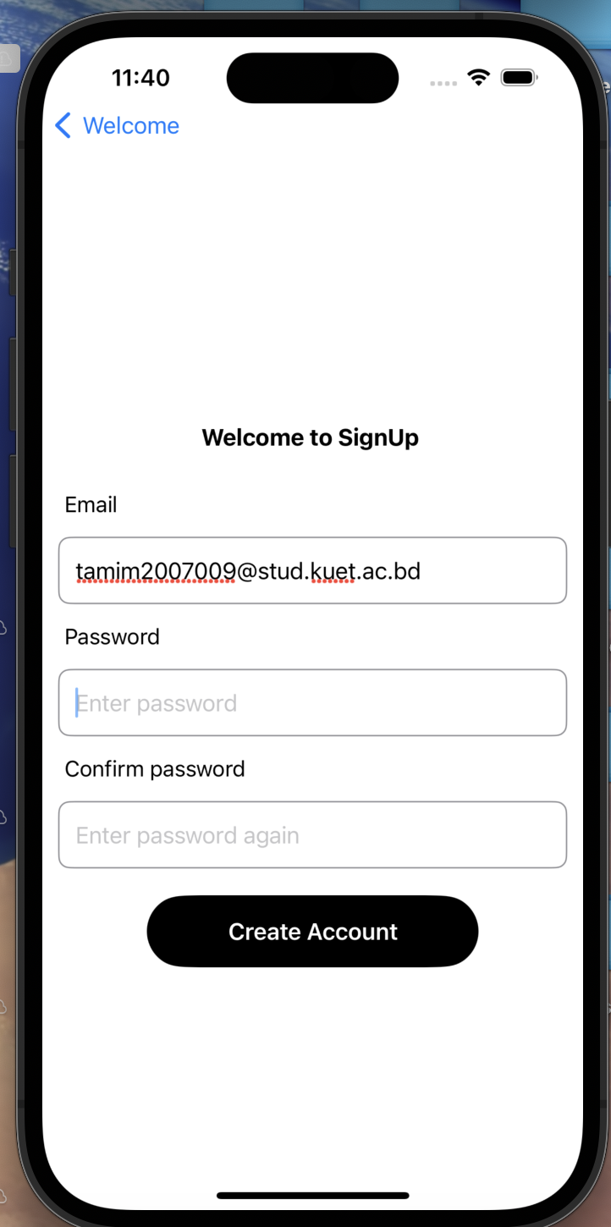
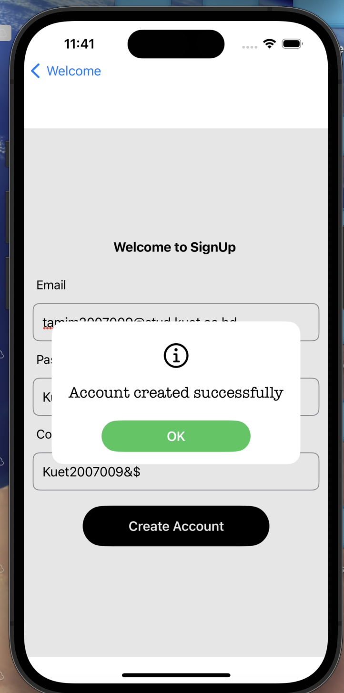
Signup Page

Slide 6
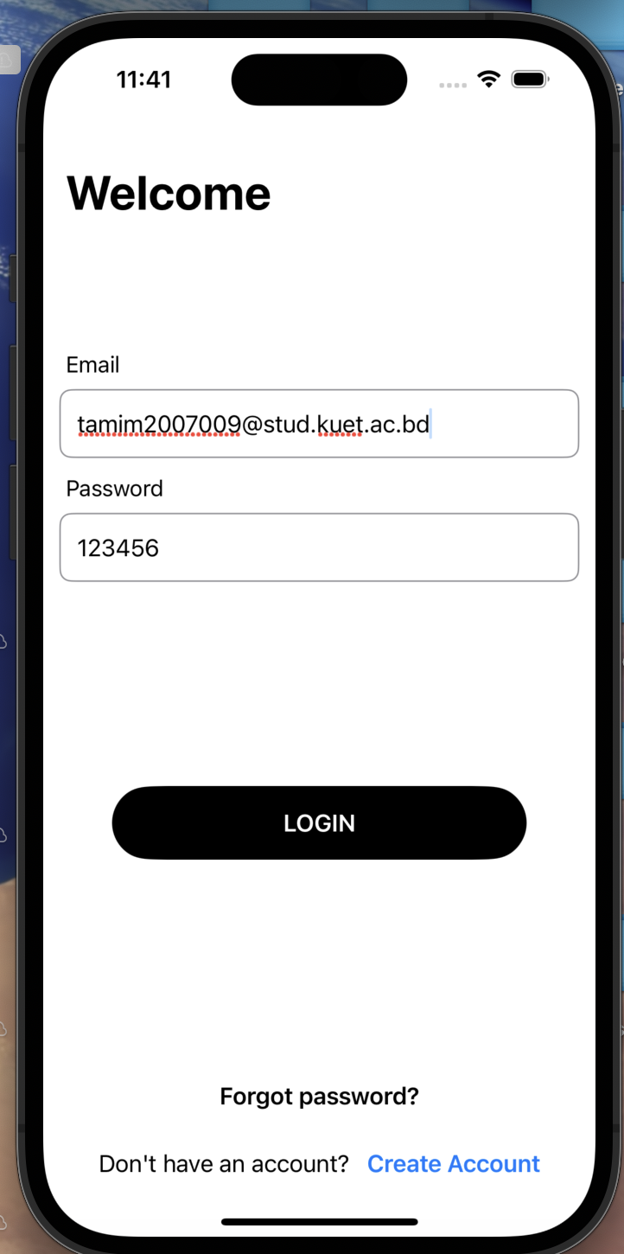
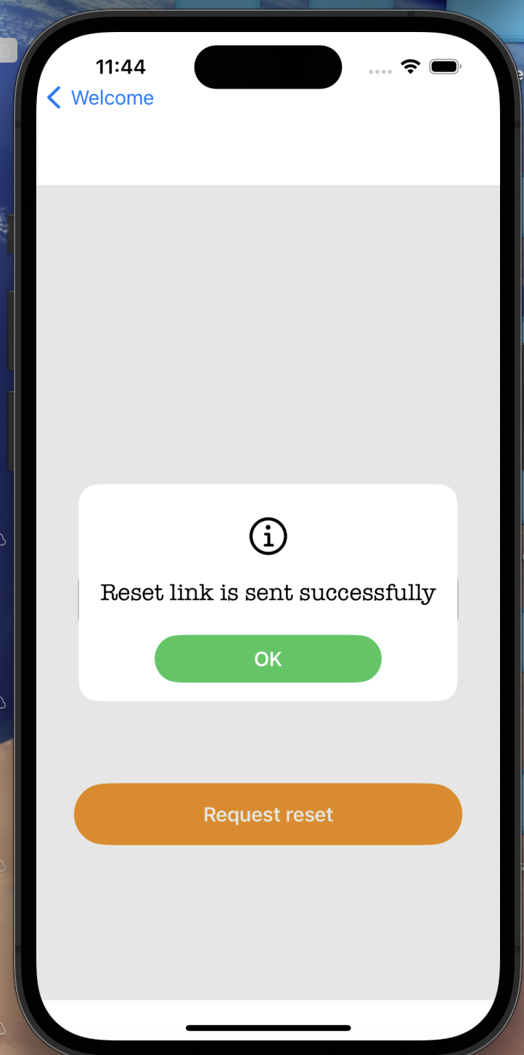
Login Page

Slide 7
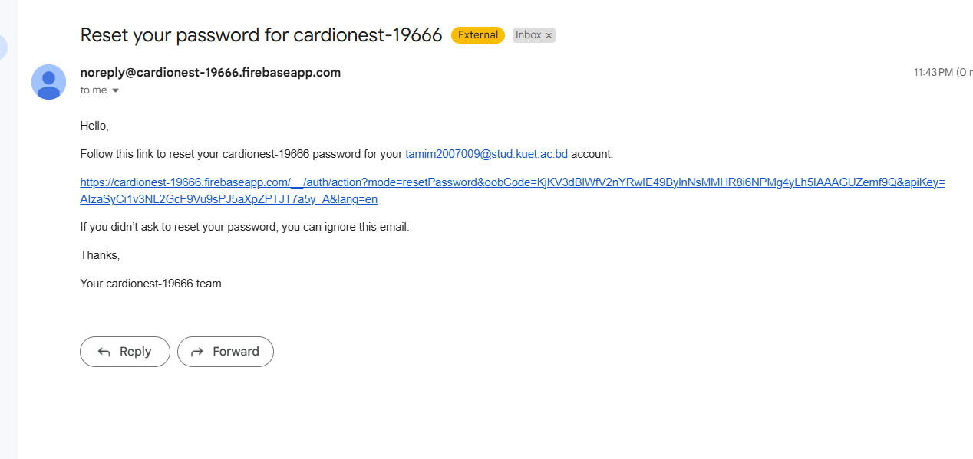
Password Recovery

Slide 8
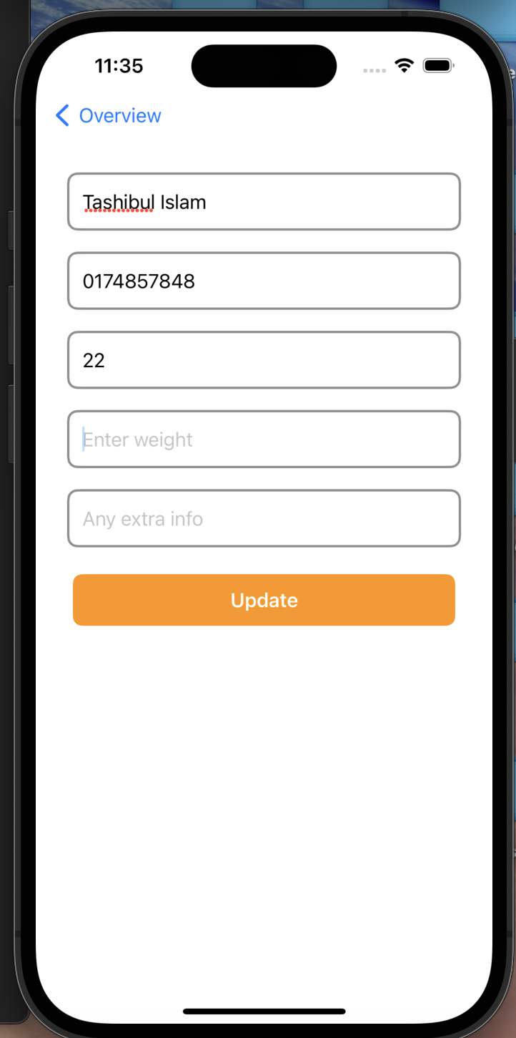
Profile Management

Slide 9
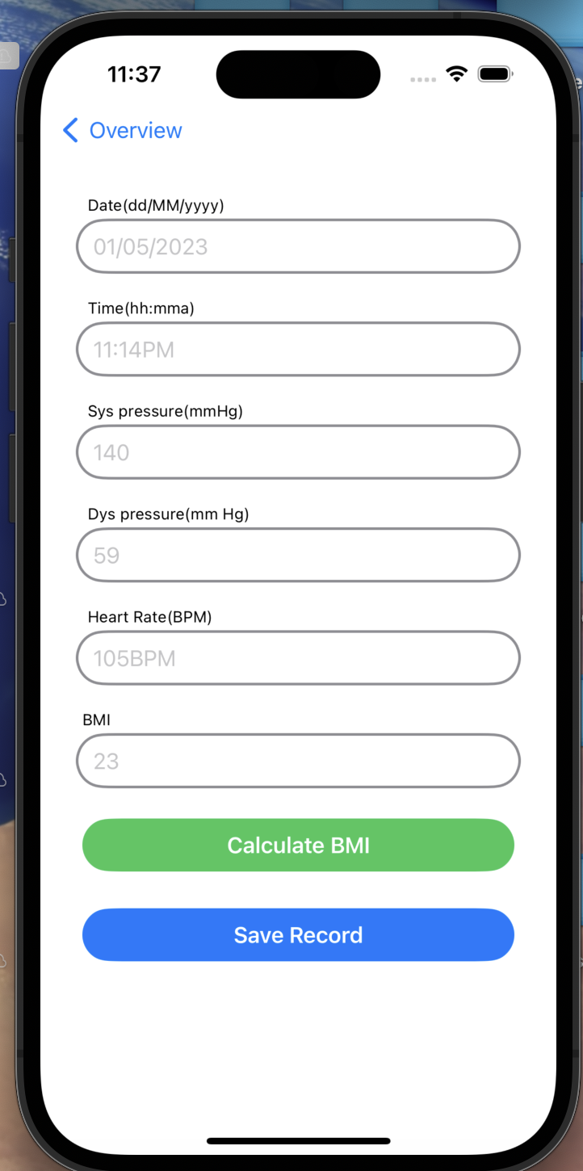
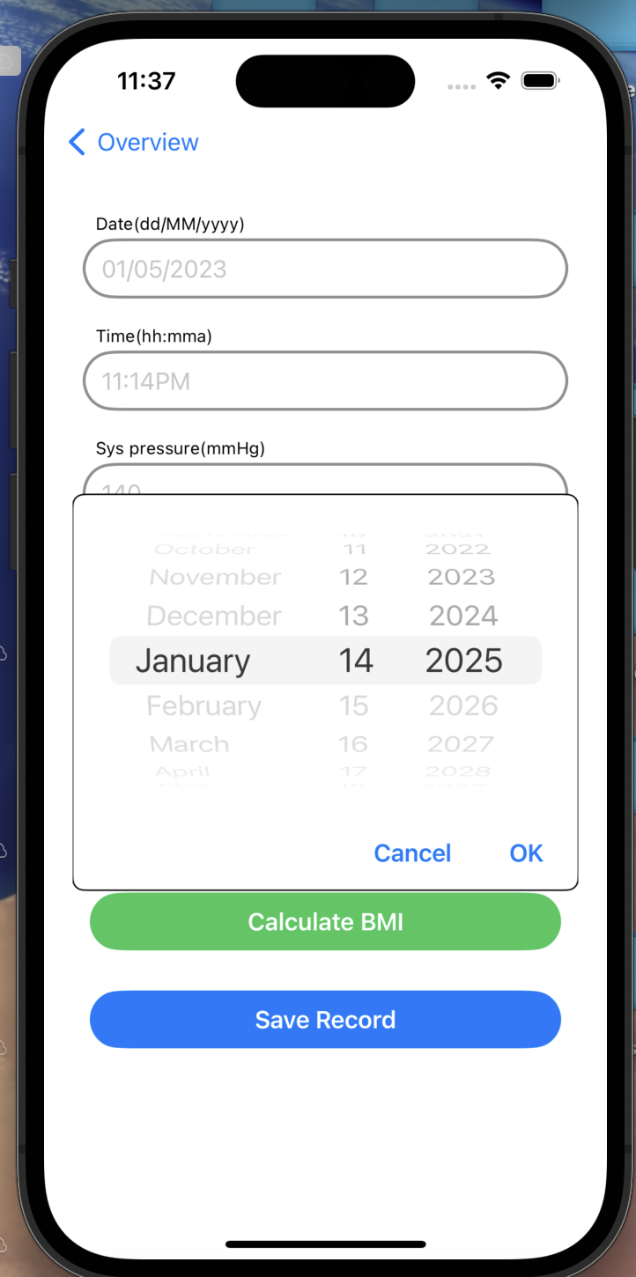
Manual entry

Slide 10
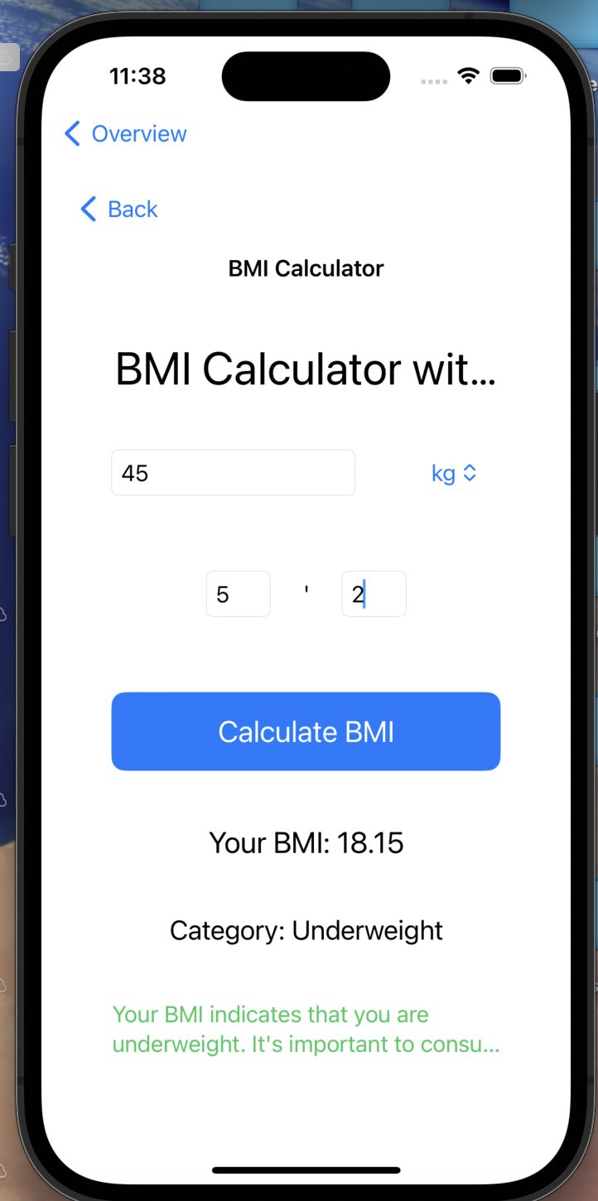
BMI calculation

Slide 11
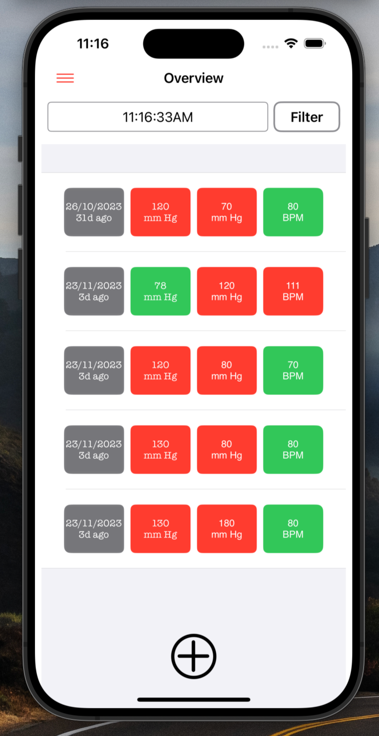
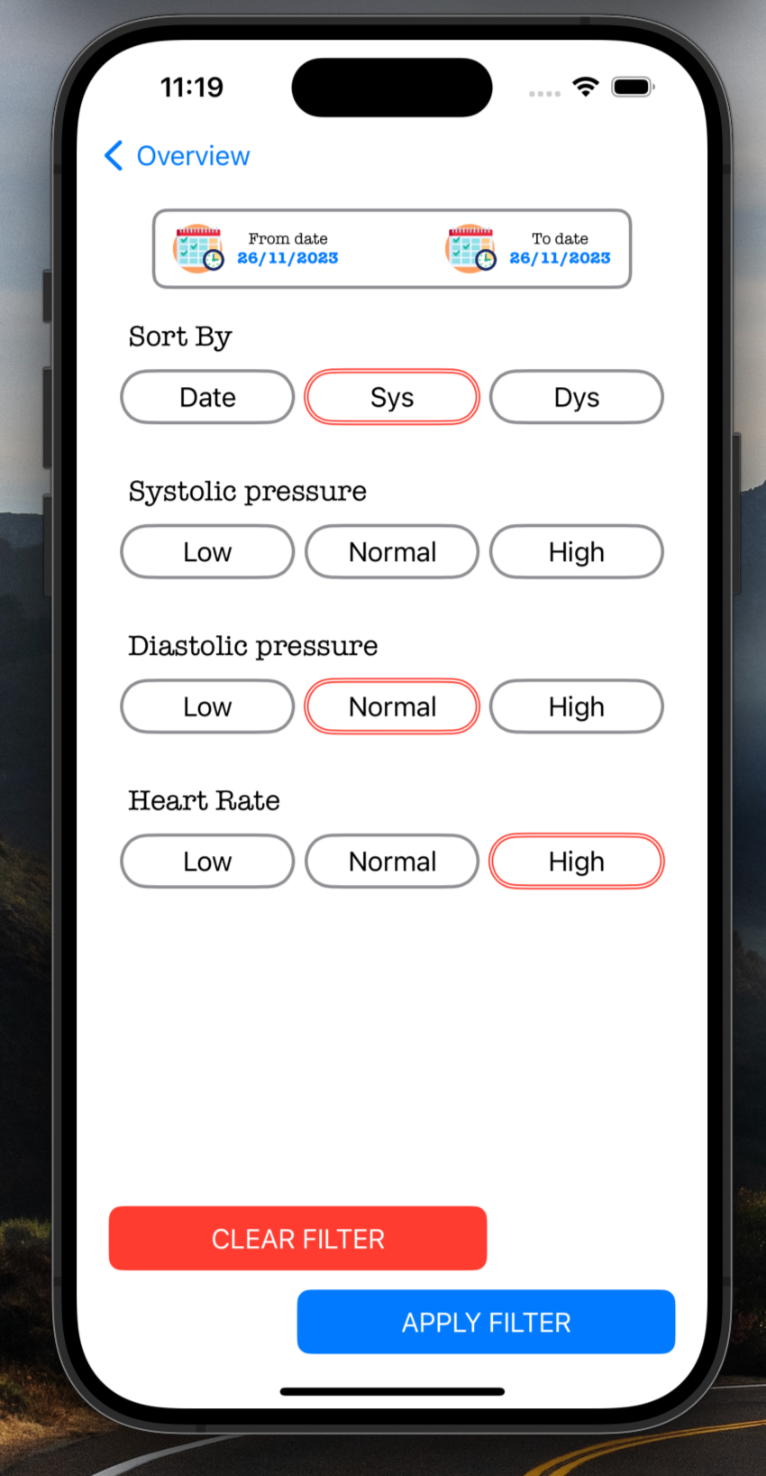
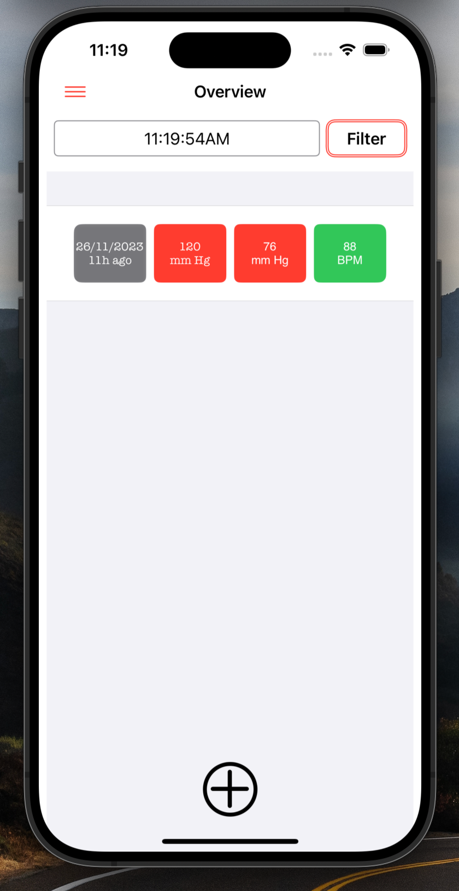
Details health record and Filter

Slide 12
API Integration
API Integration:
- Provides health-related tips about heart health and blood pressure.

Slide 13
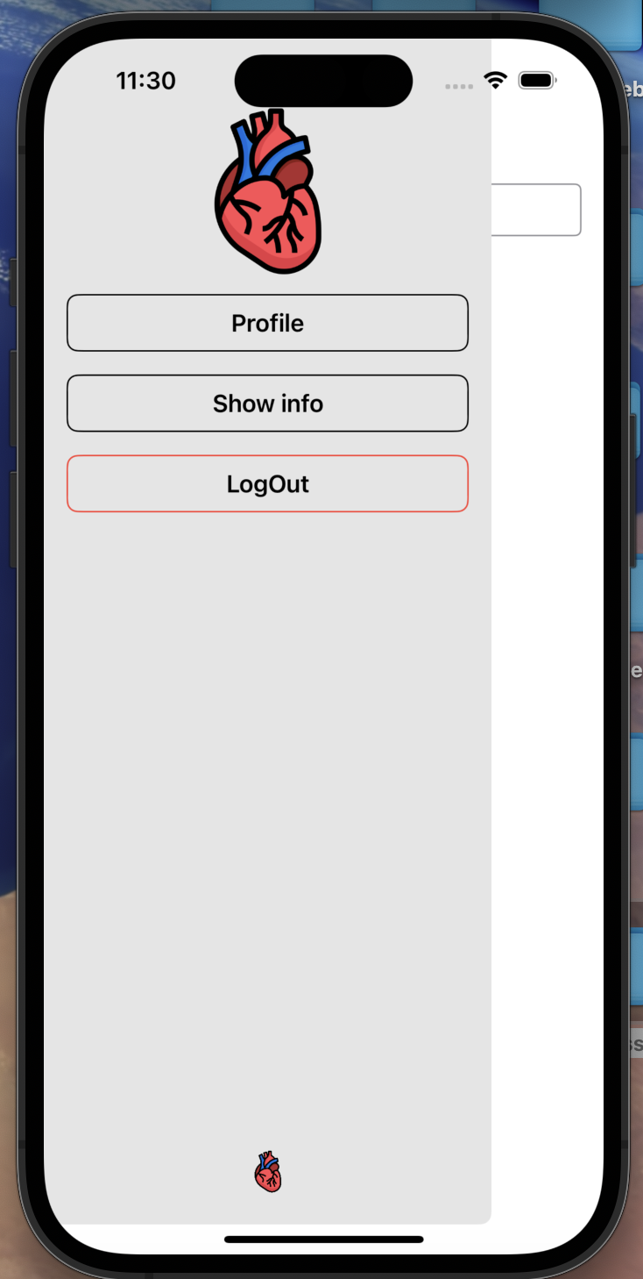
Navigation Drawer Options

Slide 14
Navigation Drawer Options
1. Profile: View or edit user information.
2. Health Tips: Access API-based content.
3. Logout: Securely sign out.

Slide 15
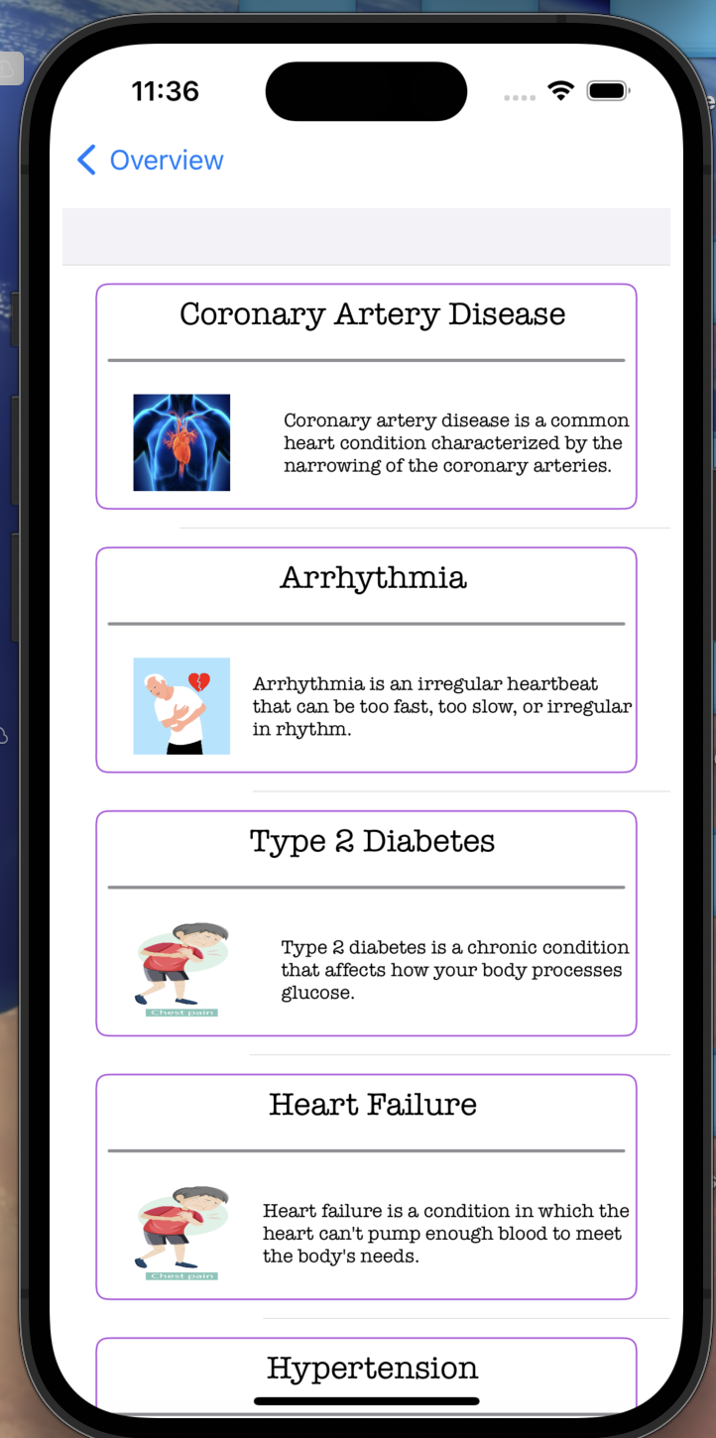
API Integration

Slide 16
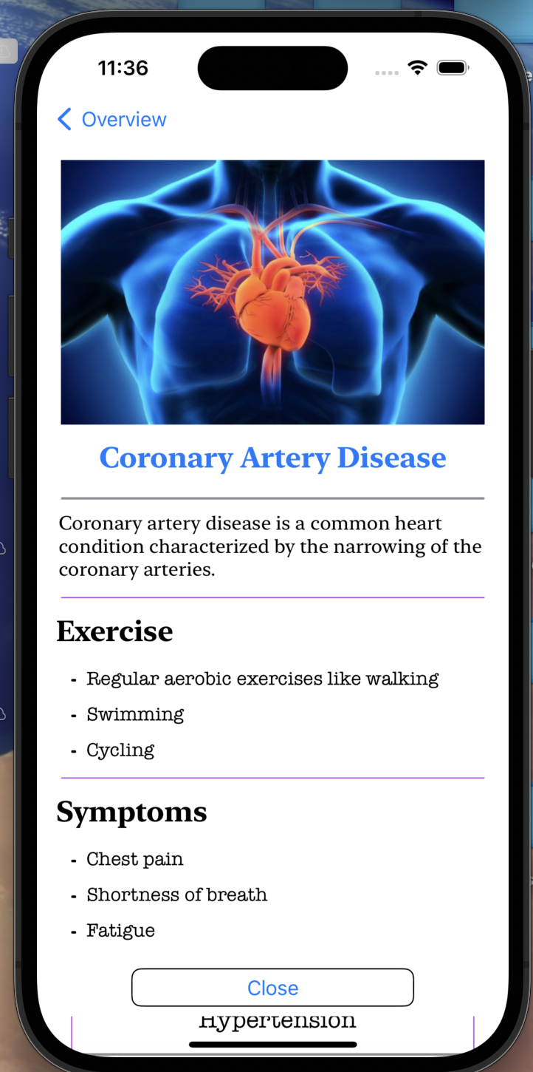
API Item Details

Slide 17
Technical Implementation
Development Environment:
- Language: Swift
- IDE: Xcode
- Database: Firebase Realtime Database

Slide 18
Technical Implementation
Firebase Integration:
- Authentication: Secure login and password recovery.
- Database: Real-time synchronization.
- Delegate Pattern: Used in FirebaseApp.configure().

Slide 19
Conclusion
Comprehensive health tracking app with robust features.
Modular and scalable design.
Future-ready for enhancements like analytics and device integration.

